Slide 1
You Bought It,
But Do You Own It?
February 14, 2013
Bill Rosenblatt
GiantSteps Media Technology Strategies
www.giantstepsmts.com
billr@giantstepsmts.com 212 956 1045

Slide 2
What happens when you buy a book?

Slide 3
You can…
Read it
Lend it
Sell it
Give it away
Use as doorstop

Slide 4
What happens when you buy an ebook?

Slide 5
You can…
Read it
Lend it
Sell it
Give it away
Sync devices
Use as doorstop

Slide 6
What happens when you buy a
DRM-free ebook?

Slide 7
You can…
Read it
Lend it
Sell it
Give it away
Sync devices
Use as doorstop

Slide 8
You may…*
Read it
Lend it
Sell it
Give it away
Sync devices
Use as doorstop
*In most cases.

Slide 9
Why?

Slide 10
Sale vs. License
Physical Products
Digital Downloads
Sale
Copyright bundle of rights
Store is a seller
User is a buyer
Publisher and seller cannot restrict rights
License (EULA)
Store’s Terms of Use
Store is a licensor
User is a licensee
Publisher and seller can set whatever rights they want

Slide 11
The First Sale Doctrine
(17 USC § 109)
“…the owner of a particular copy or phonorecord lawfully made under this title, or any person authorized by such owner, is entitled, without the authority of the copyright owner, to sell or otherwise dispose of the possession of that copy or phonorecord.”

Slide 12
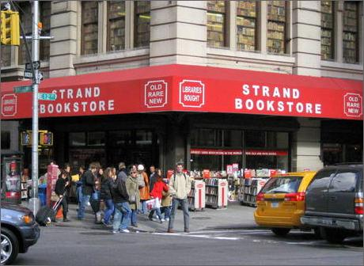
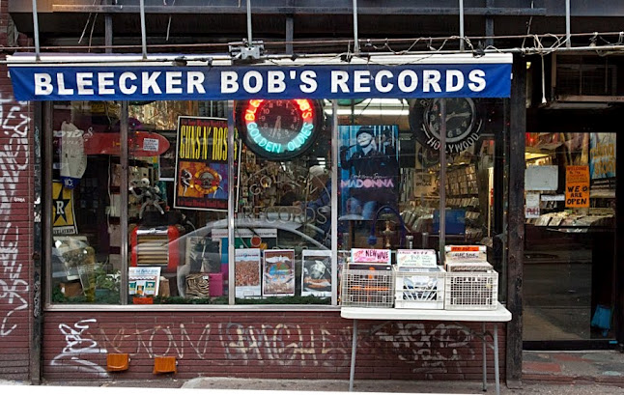

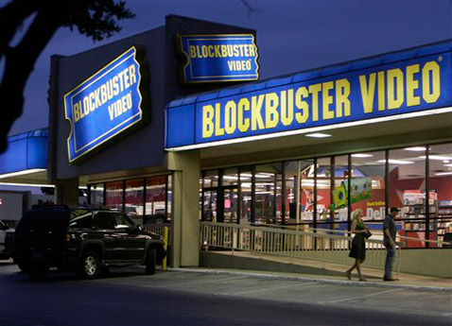
Thanks to First Sale…

Slide 13

Digital First Sale

Slide 14

What Is Digital First Sale?
Read it
Lend it
Sell it
Give it away
Sync devices
Use as doorstop

Slide 15
Sounds great…

Slide 16
…but do we* really want this?
*Authors, publishers, distributors, retailers

Slide 17
Disruptive Implications: Retail
Anyone can resell their files
Marketplaces will appear
Big e-retailers will add resale
Don’t forget eBay
Price will be the only differentiator
Digital resale will be a must-have

Slide 18

Disruptive Implications: Retail

Slide 19
Disruptive Implications: Retail
SELL YOUR EBOOKS. GET GIFT CARDS.
Just click to return them and get up to 70% back.
JOIN OUR RESELLERS NETWORK TODAY.
Get credits for returning ebooks. Return them faster for
more credit. Earn bonuses for returning more!
THE HUNGER GAMES VII NOW AVAILABLE!
$9.99 New
$7.99 from our Resellers’ Network, while supplies last
Publisher gets revenue
Publisher gets no revenue
AUTHORS: PUBLISH WITH US.
New: earn royalties from our Resellers’ Network!

Slide 20
Frontlist Revenue
$
Digital First Sale
Time

Slide 21
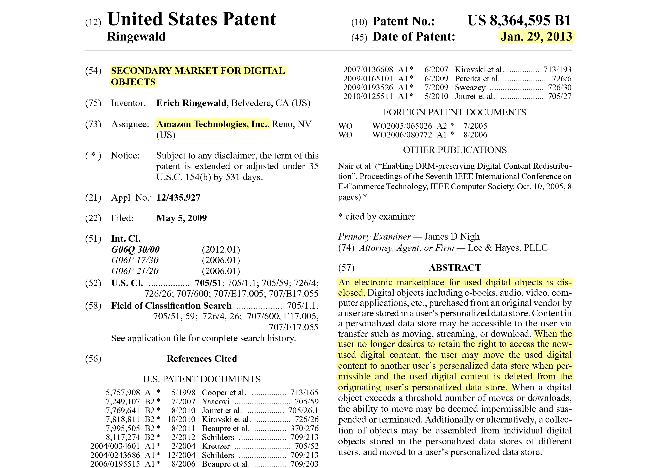
And Now, the Punch Line

Slide 22
Disruptive Implications: Libraries
Libraries can lend ebooks freely
Publishers can’t forbid or restrict
Copies last forever, don’t wear out
No more confusion & complexity

Slide 23
Big 6 Trade Publishers
Library E-lending Policies
Publisher | Policy | Pricing
Hachette Book Group | Backlist only, published April 2010 or earlier | Higher than consumer
HarperCollins | 26 loans per title
Macmillan | Limited catalog, 2 years or 52 loans per title
Penguin | 1 year per title starting 6 months after pub date
Random House | Full catalog, no restrictions | Higher than consumer
Simon&Schuster | No licensing to libraries

Slide 24
With Digital First Sale
Publisher | Policy | Pricing
Hachette Book Group | Full catalog, no restrictions | Same as consumer
HarperCollins | Full catalog, no restrictions | Same as consumer
Macmillan | Full catalog, no restrictions | Same as consumer
Penguin | Full catalog, no restrictions | Same as consumer
Random House | Full catalog, no restrictions | Same as consumer
Simon&Schuster | Full catalog, no restrictions | Same as consumer

Slide 25
Legal Developments

Slide 26
Litigation: Sale vs. License
The Duck Test
  Looks/quacks/swims like a duck
  If license terms are enough like a sale, should it be treated as a sale?
  Answer: unclear*
  Contrapositive is settled law:
  if it doesn’t look/quack/swim like a duck, it’s not a duck
Recent relevant cases
  Quality King Distributors v. L’anza (Supreme Court, 1998)
  Vernor v. Autodesk (9th Circuit, 2010)
*In United States

Slide 27
Amazon’s Terms of Use
Kindle ebooks
“… the Content Provider grants you a non-exclusive right to view, use, and display such Kindle Content an unlimited number of times, solely on the Kindle or a Reading Application … solely for your personal, non-commercial use. Kindle Content is licensed, not sold, to you by the Content Provider.”

Slide 28
Amazon’s Terms of Use
MP3 Music
“…you may not redistribute, transmit, assign, sell, broadcast, rent, share, lend, modify, adapt, edit, license or otherwise transfer or use the Music Content. We do not grant you any synchronization, public performance, promotional use, commercial sale, resale, reproduction or distribution rights for the Music Content.”

Slide 29
Copyright Office 2001 Report
Copyright Office: copyright advisor to Congress
Asked to provide opinion on Digital First Sale
Can’t trust users to take step of deleting files
Requires universal “forward and delete” scheme
Such mechanism not practical
…so therefore let’s leave well enough alone

Slide 30
Technical Implications
Forward-and-Delete mechanism
Would have to delete all copies: backups, synced, etc.
Questions about whether copies made during this process are “incidental” or infringing
IEEE P1817 standard for “Consumer Ownable Digital Personal Property” – a DRM-like scheme

Slide 31
Business Developments

Slide 32
Digital Resale Businesses
Lexink
  UNLODER forward-and-delete technology
ReDigi
  Resell MP3s purchased on iTunes & Amazon
ReKiosk
  Resell content where owner has given permission
Failures: Weed, Peer Impact, File-Cash, Bitmunk, Bopaboo
  All music, some using DRM or watermarking

Slide 33

Enables resale of MP3 music files
  Takes a cut
  Gives labels or artists a cut
Detects MP3s user bought from Amazon & iTunes
  Looks at metadata and watermarks in files
Implements forward-and-delete
  Deletes copies on, attached to, or copied to your PC/Mac
  Probably can’t delete synced copies on your phone
Moving into ebooks

Slide 34
ReDigi’s Legal Quandaries
Being sued by Capitol Records (EMI)
Seen as test case for Digital First Sale
Yet even if Digital First Sale holds:
  Users violate retailers’ Terms of Use*,
  but do copyright rights trump Terms of Use?
  If label/publisher gets a cut of the resale,
  is it still First Sale?
  Are copies made to implement forward-and-delete?
  If so, are they “incidental” or infringing?
*Especially Amazon’s.

Slide 35
Publishers vs. Libraries
Service providers (OverDrive, 3M, Baker & Taylor) license ebooks on libraries’ behalf
Confusing tangle of licensing restrictions
War of words between ALA and publishers
Libraries claim to help sales through discovery
Publishers skeptical, despite recent OverDrive study
Libraries probably doomed unless law changes

Slide 36

Strange Bedfellows:
The Owners’ Rights Initiative
“If you bought it, you own it”

Slide 37











Strange Bedfellows:
The Owners’ Rights Initiative

Slide 38
Who Wins and Who Loses?
A First Guess
Winners
Losers
Users
Authors
Publishers
Retailers that sell “used”
Retailers that don’t sell “used”
Libraries

Slide 39
Questions and Discussion?
Bill Rosenblatt
GiantSteps Media Technology Strategies
www.giantstepsmts.com
billr@giantstepsmts.com 212 956 1045

